Slide 1
Mixed models

Slide 6
Variance partition
total
between
within

Slide 7
Mixed models split the error term
Standard multiple regression - i represents an individual
Mixed regression - i represents an individual, j represents a measurement

Slide 8
This is the 'fixed' part which is just like lm
This is the 'random' part of the model
library(lmerTest)
lmer(outcome ~ predictor + (1|grouping),
data=data)
The 1 just means add an intercept
This is the grouping variable

Slide 9
Random intercepts model
Random != scattered or unpredictable…
It means we treat individuals' 'intercepts' (their mean scores) as a random variable… i.e. one which is measured with error

Slide 11
Random slopes
We can also allow the effect of X to vary between people (see the different lines here.
This gives us:
Average effect of X
Effect within each person
Variation in effects?
i.e., does everyone have same slope?

Slide 13
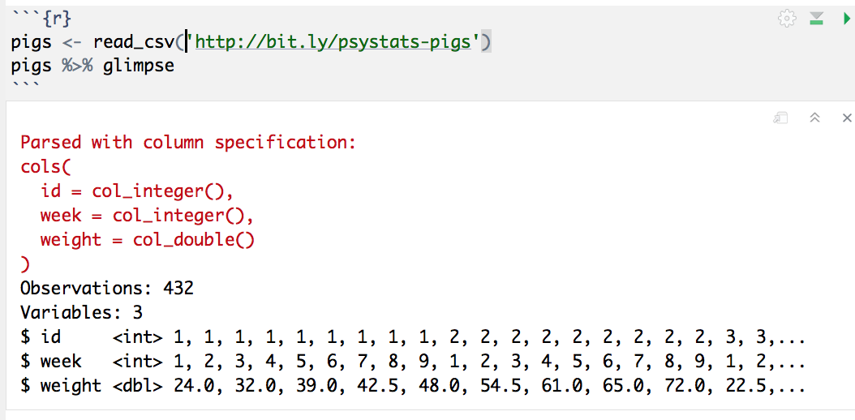

Slide 14
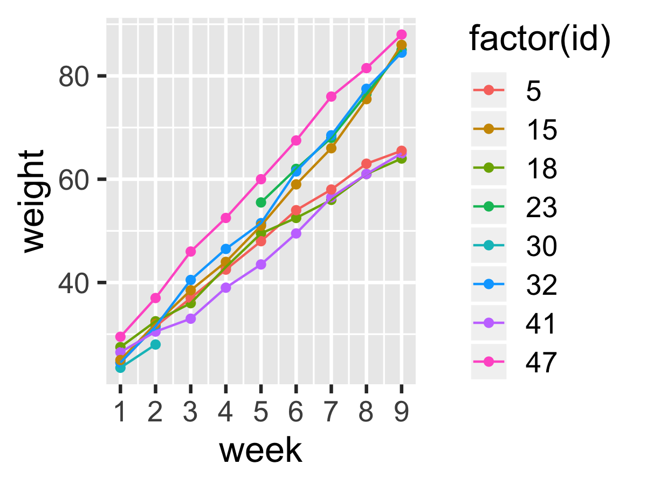

Slide 15
This is the 'fixed' part which is just like lm
This is the 'random' part of the model
lmer(weight ~ week + (1|id), data=pigs)
The 1 just means add an intercept
This is the grouping variable

Slide 16
What if we want to allow for piglets to be different?

Slide 17
The fixed part stays the same
lmer(weight ~ week + (week|id), data=pigs)
Now we add a predictor to the random part… this adds a 'random slope', allowing slopes to vary by-id

Slide 18
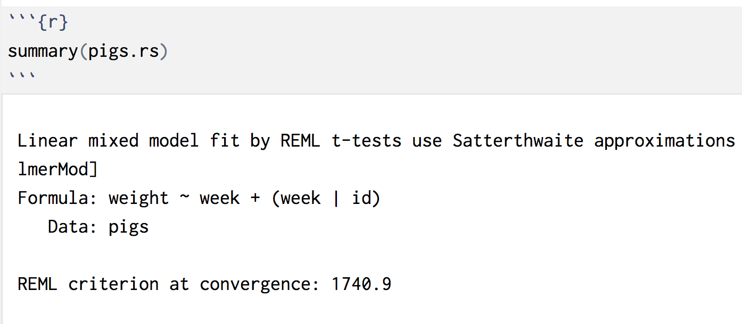
Random slopes model output

Slide 19
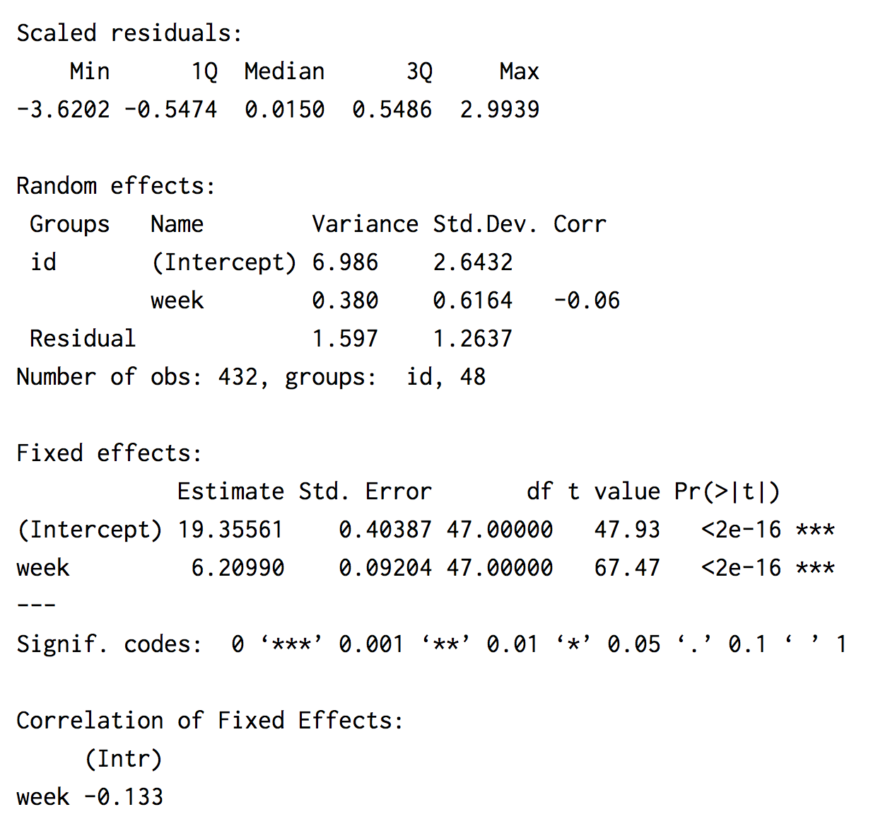
Random slopes model output
Use ranova() to test
Interpret this part just like `lm`
Ignore this part
Notes:
Run
options(lme4.summary.cor.max = 0)
To hide fixed effect corrs

Slide 20
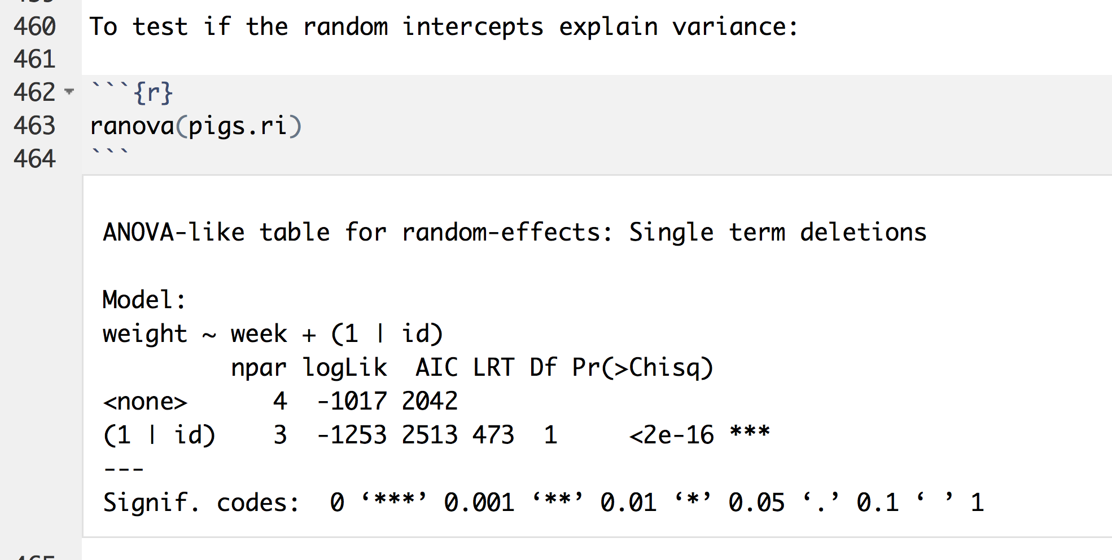
Test of random intercept
Tells us if there is 'significant' variation in intercepts. i.e. was it "worth it" to fit mixed model

Slide 21
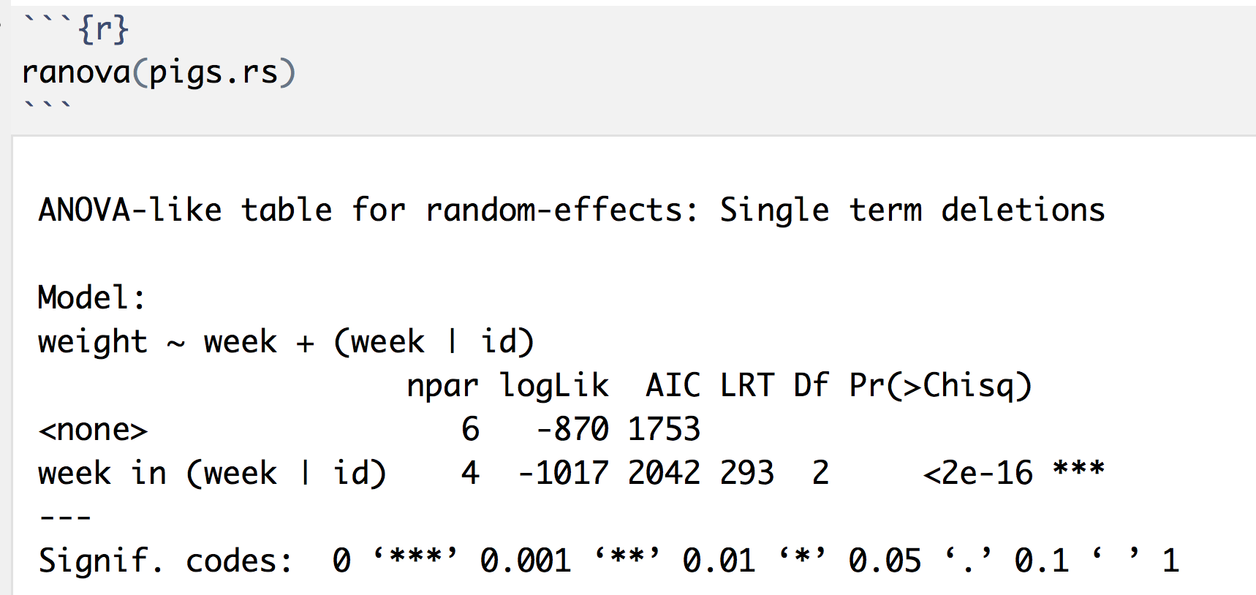
Test of random slope
This asks: "was there significant variation in the slopes of different piglets?"

Slide 22
Likelihood ratio test
Instead of the F test, likelihood ratio test
Allows comparison of nested models with
Same data
Different numbers of parameters
Chi Sq with degrees freedom fixed by difference in # of parameters
If "significant", then simpler model is judged worse than more complex one, (so prefer the more complex)
See this page for more technical details
https://www.ssc.wisc.edu/sscc/pubs/MM/MM_TestEffects.html or http://www.bodowinter.com/tutorial/bw_LME_tutorial.pdf

Slide 23
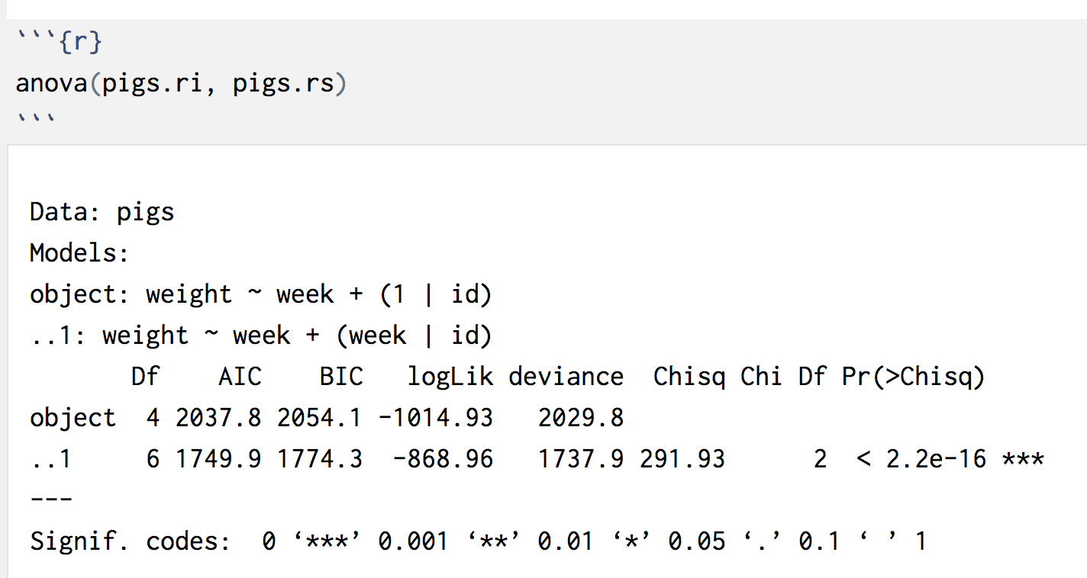
Likelihood ratio test
Simpler model
More complex model
p value that simpler model is worse/more complex is better
Number of additional params

Slide 24
Interpreting/reporting
Does removing variables from a complex model make it fit worse?
-> If it does, prefer the complex model
A likelihood ratio test revealed that a model without a random slope for X produced a significantly worse fit, χ²(2) = 7.22, p = .018.
Or: The random intercept model was significantly improved by adding a random slope for X, χ²(2) = 7.22, p = .018.
Or: There was substantial variation in the effect of X between-participants, χ²(1) = 4.5, p = .011.

Slide 25
Assumptions to make it work
e_{ij} and u_{0j} (and random slopes) are normally distributed
If we have random slopes + intercepts then u_{0j} and u_{1j} are correlated (parameter estimated)
These distributions mean we just estimate 1 parameter (the variance in intercepts, for example), not a separate intercept or slope for each group.
We look at model residuals to estimate the slope within each cluster (if we want to delve into individual cases)

Slide 26
Variance explained in mixed models
Variance explained and variance proportions

Slide 27
Nakagawa and Schielzeth 2013 and Johnson, 2014
Extend R² to mixed models
Marginal R²
Same interpretation as for lm
Conditional R²
Variance explained, once random effects accounted for
Variance parameters describe distribution of people/schools/therapists etc…
Not built-in, must use MuMIn::r.squaredGLMM
Interpret and report as you would for lm/R²

Slide 28
Variance partition
total
between
within

Slide 29
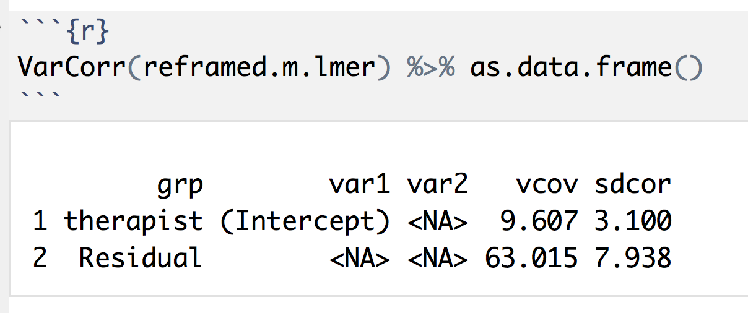
Trick: Use VarCorr after lmer and convert to dataframe to show variances

